Slide 1


MS MARCO Datasets: MRC, IR, KP
Daniel Campos, Program Manager, dacamp@microsoft.com

Slide 2
Agenda
Problem introduction
Introduce Datasets
Problems in creating large datasets
Tips for creating datasets
Shameless Plug
Do well on dataset get an interview.

Slide 3
What is a Search Engine
A system that provides information to users
Returns relevant documents from a corpus for user queries
Find Answers in each document.
A cool AI/ML experimentation platform.
A research platform to explore human knowledge and experience

Slide 4
How does a Search Engine Work?
Internet
Query
Crawling
Index
L1 Ranking
L2 Ranking
QA
NLGEN
Smart Speaker
IDF Lookup
Document Ranking
Span Identification
Answer Generation

Slide 5
What is MSMARCO
A family of dataset which approximate a search engine
Question Answering
Natural Language Generation
Passage Ranking
Document Ranking
Keyphrase Extraction
Optimal Crawling
AGI Encoder
Conversational Search

Slide 6
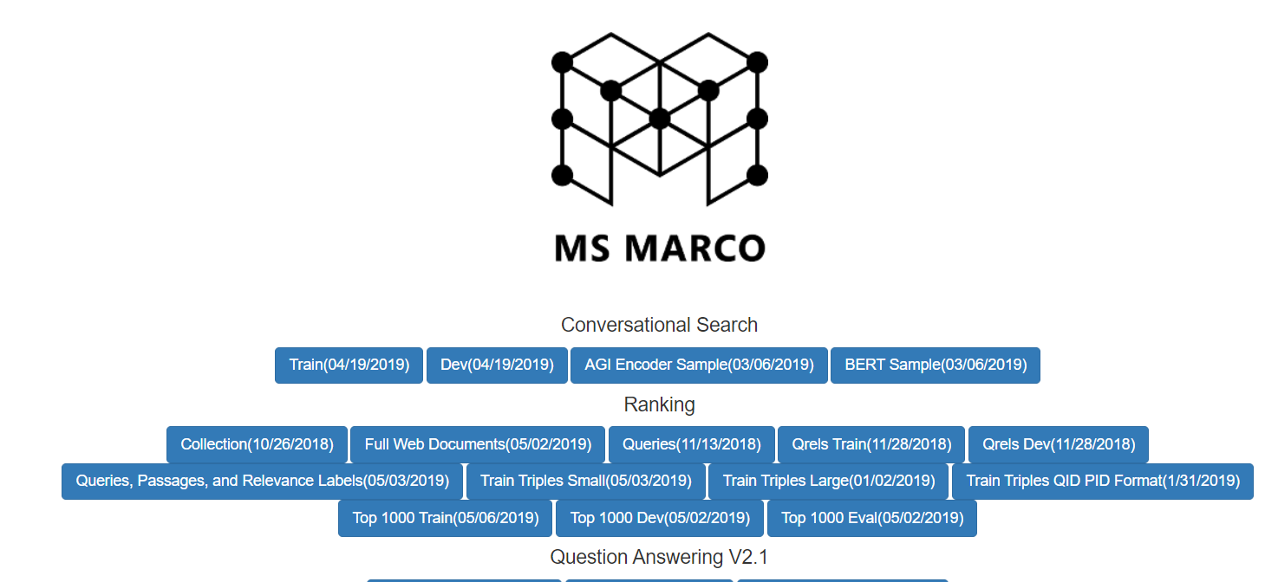
Microsoft – MS MARCO

Slide 7
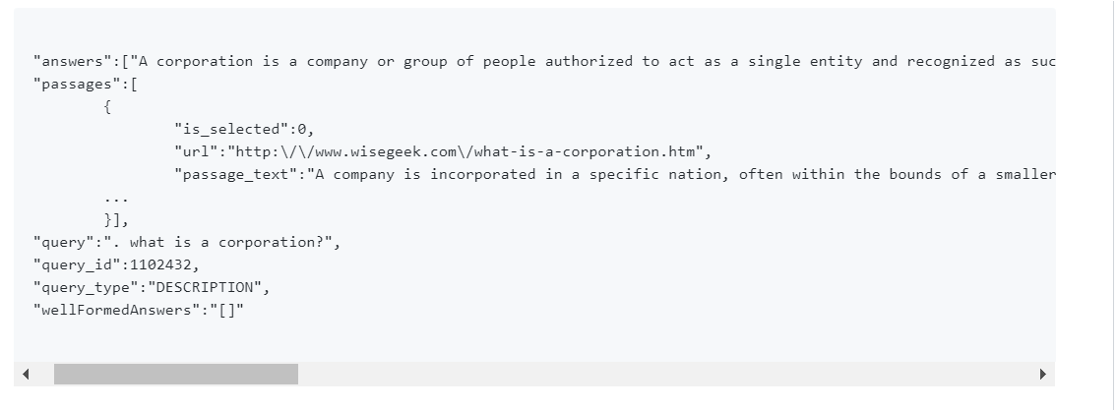
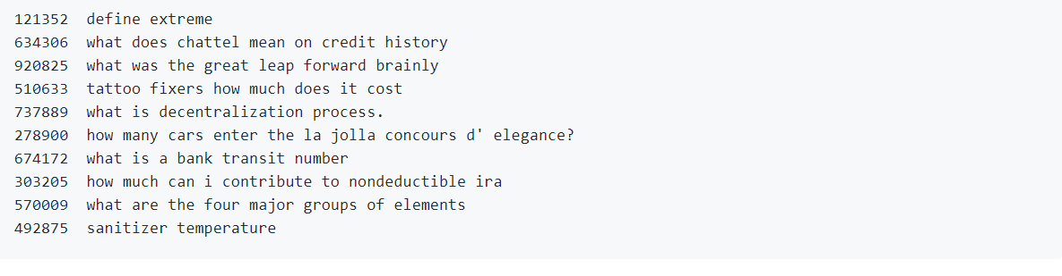
Q&A
Given an open domain user question and 10 passages generate the best answer
Start with sampling ~10,000,000 real Bing user queries from bing traffic in 2016-2017.
Remove navigational queries and create a set of ~1.1m queries seeking an answer.
Search Bing and get top 10 Passage(Short snippets of text less than 300 words)
Train a group of judges to read question, passages, select passage with answer and synthesize answer.
35% of queries have no answer
Paper: 2016 NeuRIPS(100k), updated in 2018 to have 1,000,000.
Metrics BLEU and ROUGE-L

Slide 8
NLGEN
Start with QA results for each answer a second human takes the source passage, answer, and question and makes a well formed answer.
Target is something that makes sense to a human independent of the question
Ex
Question: How many teaspoons in a cup
Answer: 16
Wellformed answer: They are 16 teaspoons in a cup.
Requires including information from answer, query, and general English
Metric is BlEU and ROUGE-L
~180k judgements

Slide 9
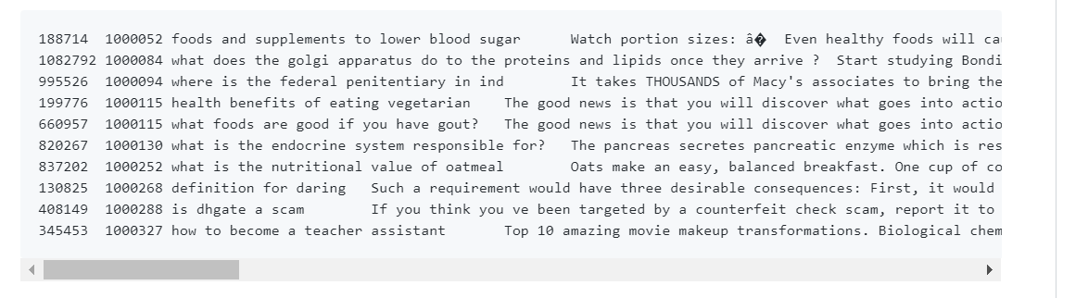
Passage/Document Ranking
Corpus of 8.8m passages and 3.5m documents
Ranking signal comes from which passage QA task judges used(~550k samples)
TREC 2019 & 2020
Metric is MRR@10(leaderboard) and NDCG@1000 in TREC
TREC 2020 is focused on Transfer Learning

Slide 10
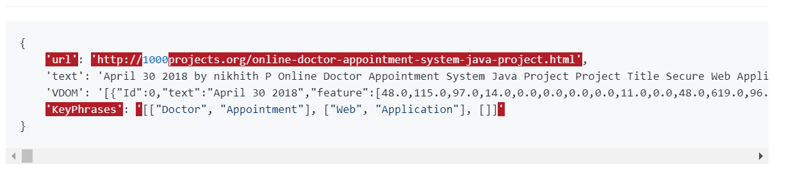
KeyPhrase Extraction
Given an open domain document how do you extract the most relevant key phrases?
Corpus is 150k web documents(urls) sampled from Bing index. Each document has been annotated for most salient keyphrases
Human explored website and then selected the 1-3 most salient key phrases
Paper @ EMNLP 2019
VDOM(visual representation of text) included for corpus
NEW!(10/22/2019)
Metric is F1 for top 3 keyphrases.

Slide 11
Optimal Crawling
Given the changing internet how do you crawl optimizing content freshness and efficient resource usage
Paper 1 @SIGIR 2019 and Paper 2 @ NeurIPS 2019
Dataset
Non NLP Focused

Slide 12
Microsoft – Generic Intent Encoder
Generates vector representation of queries, cosine of which compares their similarity
Paper @ SIGIR 2019 https://msturing.org/
Query 1​ | Query 2​ | Gold Relationship​ | GEN Similarity​
Vietnam high leggedchicken​ | Camaroonwescoe​ | Unrelated​ | 0.05​
Battle of Trenton 1776​ | battle of yorktown​ | Related topically​ | 0.58​
core curriculum research​ | common core researcresults​ | Focused | 0.78​
how to create a newoutlook.com email adress​ | create a new outlook emaiaccount​ | Co-intent​ | 0.90​

Slide 13
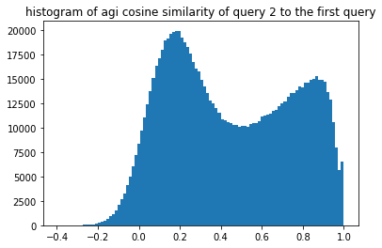
Microsoft – Generic Intent Encoder
Plot histogram of GEN Cosine of every adjacent query pair in all sessions
Focus
Explore
Co-intent
Un-Related

Slide 14
MS Generic Intent Encoder
Input:
curl https://api.msturing.org/gen/encode -H "Ocp-Apim-Subscription-Key: <YOUR KEY HERE>" --data '{"queries": ["JHU Hackathon starts now!", "Microsoft Bing Turing team is here to help you"]}'
Output
[{"query":"JHU Hackathon starts now!","vector":[-0.566877544,-0.7660154,0.0386078022,0.211503863,0.698292851,0.80953,0.5733553,-0.9140808,0.4710587,0.6242295,0.404078245,-0.117339104,0.333207667,0.5637362,0.1986959,-0.676619649,-0.07769296,-0.256009638,0.491425425,-0.5555389,-0.4690127,-0.0160620678,0.640714943,0.390773356,-0.90940094,0.203325078,0.685021,0.130174279,-0.608111858,0.923422337,-0.6334969,0.2002903,-0.255215466,-0.635771036,-0.799076,0.0169438049,0.1878385,0.766254663,-0.627372146,-0.494734377,-0.376019061,-0.5634684,0.0267866049,-0.367818832,0.159700051,0.4233715,0.431343764,0.8297644,-0.104869679,0.420928985,-0.441808969,0.43333897,-0.66815263,0.50148946,-0.5738398,-0.6945562,0.105353281,0.6684549,0.204674482,0.2576098,0.454096973,0.19131805,0.0189984459,0.806057334,-0.111638337,-0.2040309,0.07648222,0.401905179,-0.1416051,0.05214771,-0.287833333,0.729043663,0.0443833247,-0.04550233,-0.7436127,-0.117191344,-0.150619835,0.611227632,-0.302499026,0.594983637,-0.208013073,-0.7539891,0.183571815,-0.315082639,-0.136997119,0.311208,-0.649488032,0.40023005,-0.185172617,-0.7091202,0.5708807,0.288131654,0.6612453,-0.472738147,0.475679785,0.6222918,0.600429952,-0.5055886,-0.753935158,0.754632]},{"query":"Microsoft Bing Turing team is here to help you","vector":[-0.646957636,0.0503964163,0.3118735,-0.251204669,0.7891999,0.005780848,-0.145126551,-0.58425343,0.5009752,-0.271577567,0.6137968,-0.312289834,0.4799643,-0.0228346884,0.5262919,0.122307412,0.637292266,-0.08156615,0.9269321,-0.3807059,-0.242125183,0.23468776,-0.07079061,0.116637461,-0.8488338,0.7627651,0.6088149,-0.374497861,-0.7629749,0.5283652,-0.623724461,0.792436659,-0.446736544,-0.590692163,-0.4038152,0.215301961,-0.227195874,-0.5746267,-0.123937756,0.2544791,-0.6658275,-0.103278458,0.620797157,-0.25742656,0.18611972,0.9366491,0.670850754,0.8215309,0.09774156,0.9104743,-0.169813454,-0.6024637,-0.144887224,0.526512146,0.203458518,-0.07209335,0.147587135,-0.295552433,0.871738851,-0.3306082,-0.0157416258,-0.320369244,-0.344891876,0.320429564,-0.151437774,-0.07516683,-0.287588477,0.0923301056,-0.04096802,-0.5852924,0.861512661,0.0173219386,-0.431711078,-0.5417665,-0.523032248,-0.08963101,0.563957632,0.01077631,-0.6313811,0.0820639357,-0.6243242,-0.832725346,-0.5184782,-0.7540063,0.24076964,-0.835236847,-0.24000144,-0.585586965,0.460919,-0.681405365,-0.101287037,0.263016,0.3803259,-0.60517627,-0.453909844,-0.5420889,-0.256873429,-0.400652558,0.1672577,0.7803813]}]

Slide 15
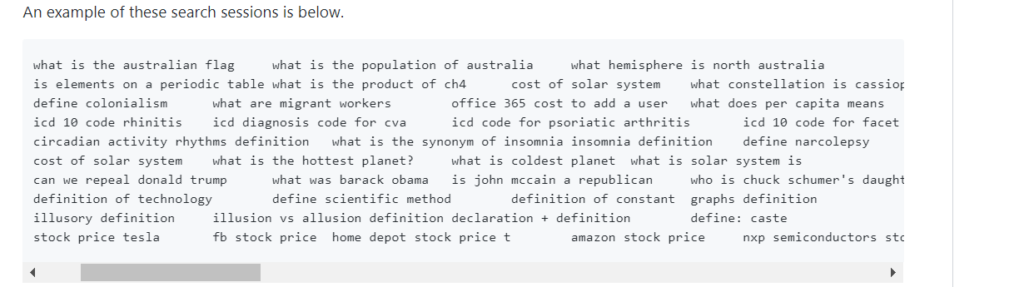
Conversational Search
Open Research no defined metric
1-n queries in user sessions
Sessions are artificial using ANN lookup with AGI encoder
Next Query prediction task coming 2020
Exploration on human intent?

Slide 16
Problems
How big is enough?
Scaling to multiple languages?
Metric?
Human Baselines?
Judge Agreement.
Krippendorff’s Alpha.
Data changes over time.
Hype is a double edged sword.
Reproducibility.

Slide 17
Tips
Start off with your idea and iterate.
Labeled Data is $$$$ so be scrappy and hackish
Establish your problem and evaluation metric before making data
The internet changes quickly so if you use it make sure to sample everything you could ever want
Temporal Mismatch
If labeling data iterate internal 10x what you expect
If you and your colleagues can’t agree why would someone random on the internet
Embrace the Quirks.
Automate everything you can. Maintenance cost for not doing so is $$$(in time)
Think about your methods with abnodation in mind

Slide 18
Shameless Plug
Try Out one of the datasets. Large benchmarks for interesting problems
Do well and get interview
Propose new dataset ideas and I’ll try to get it done.
If interested in multimodal dataset follow up with me.

